Slide 1
Predictive Churn Risk Model in Telco
CAPSTONE PROJECT BOOTCAMP 1
Bastian Ramadhan
Febtio Adi Wibawanto

Slide 2
Latar Belakang
Pelayanan penyedia jasa Telekomunikasi yang kompetitif
Perubahan jumlah pelanggan yang sangat dinamis
Manajemen pelanggan untuk menjadi pelanggan yang loyal kepada jasa telekomunikasi

Slide 3
Pendahuluan
Churn Rate
ukuran jumlah orang atau benda yang masuk atau keluar dari suatu kelompok dalam jangka waktu tertentu
Pada tahun 2010 Indonesia adalah pasar telepon seluler ke 3 terbesar di Dunia
Fenomena persaingan tingkat kualitas layanan dan tarif antara provider sangat mempengaruhi churn rate
Pengaruh Churn Rate ini sangat besar dampaknya bagi stabilitas financial dari sebuah perusahaan penyedia jasa telekomunikasi.

Slide 4

Objective
To identify the subscriber who has high propensity to churn
Tackle churn problem before customers lose engagement and churning
Model Type
We have 4 model segments
Conservative loyal (Tenure 12+ M, Non-smartphone)
High-end loyal (Tenure 12+ M, Smartphone)
Emerging potential (tenure 3-12 M)
Baby sitting period (tenure 0-3 M)
Observation Period
Prediction/
Scoring Date
(D)
M-2
M-1
D+7
D+14
Latency
Period
7 days of silence
Scoring
Date

Slide 5
Churn Risk Model – Predictors
Predictors
Lower tenure (Masa Aktif Pelanggan)
Lower days with event (event telepon, sms, atau data)
Lower days attached to network (sinyal bts)
Lower units of event (jumlah event)
Lower influence social network (pengaruh dari social network)
Lower balance (ketersediaan sisa pulsa di handphone)
Lower amount reload (jumlah pengisian pulsa)
Closer to the most recent reload
Closer to grace date (masa tenggang kartu pelanggan)
Frequent device change (distinct IMEI)

Slide 6
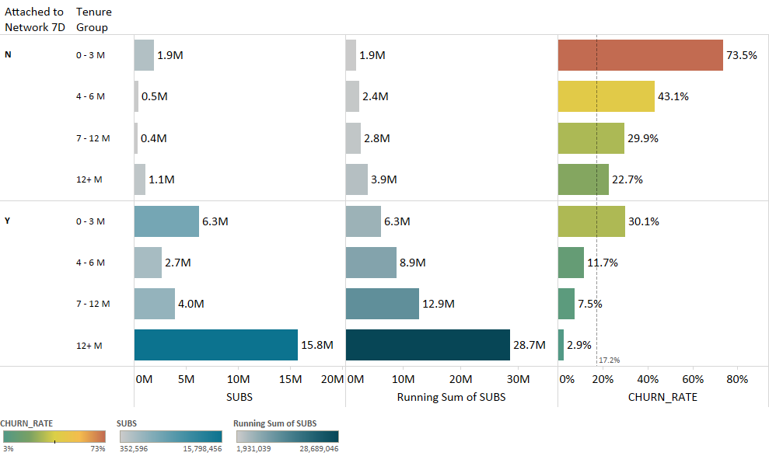
Active Subscriber
*) Sampel jumlah pelanggan yang masih aktif (attached ke bts network seleama 7 hari)

Slide 7
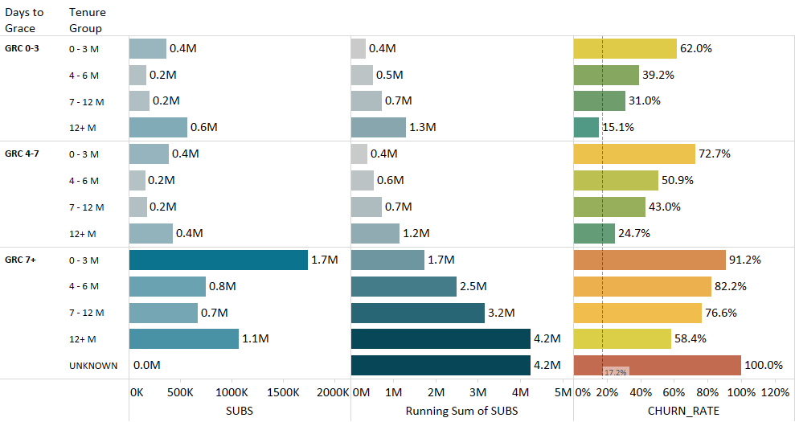
Grace Subscriber
*) Sampel jumlah pelanggan yang memasuki masa tenggang kartu (Grace)

Slide 8
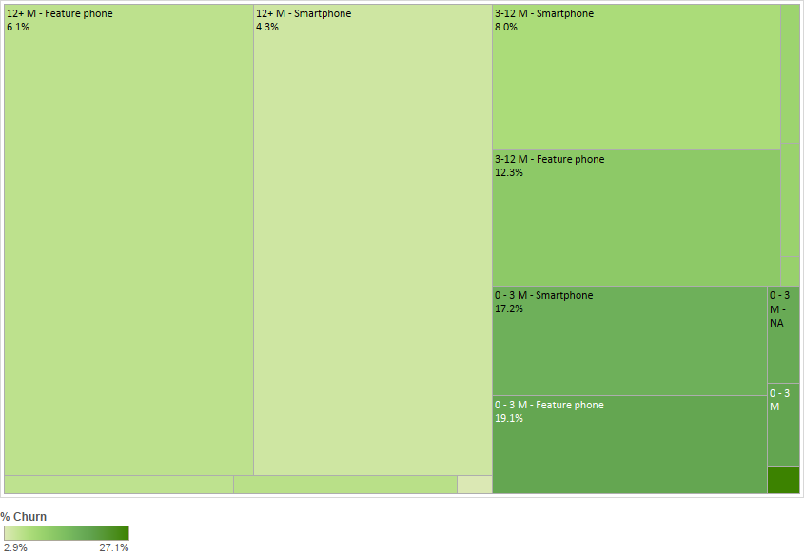
Heatmap Churn Subscriber based on tenure and device
1
2
3
4

Slide 9
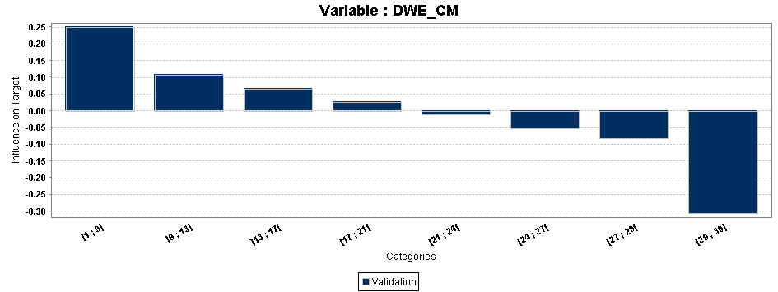
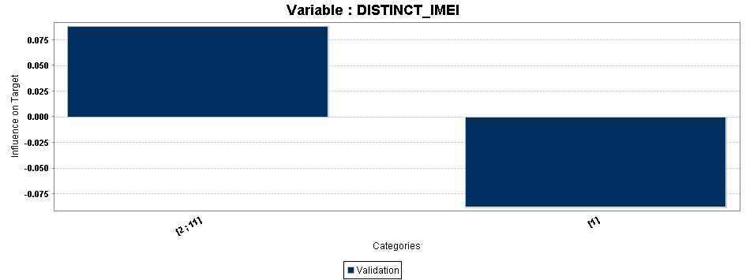
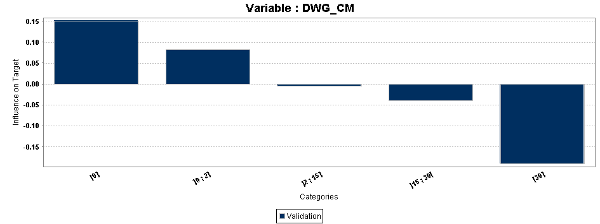
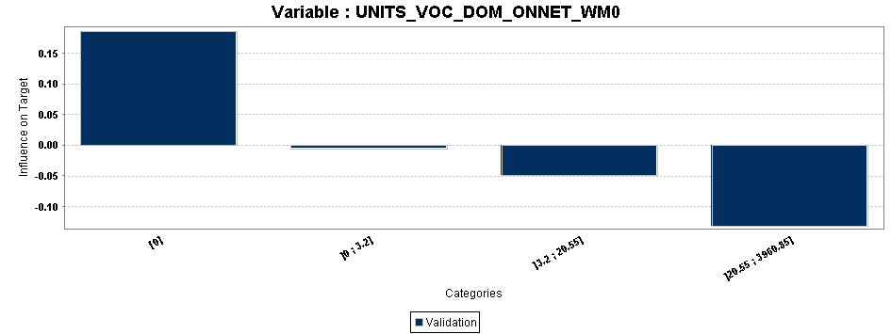
Significant variables
Total Days With Event current month
Distinct IMEI (Phone switch)
Subs with lesser DWE in current month are more likely to be sleeper (tidak melakukan event telepon,sms, atau data)
Subs who switching SIM to different phone are more likely to be sleeper
Total Days With GPRS (Internet) current month
Total Voice unit (total menit per telepon) current week
Subs with lesser DWG in current month are more likely to be sleeper
Subs with lesser voice unit in the current week are more likely to be sleeper

Slide 10
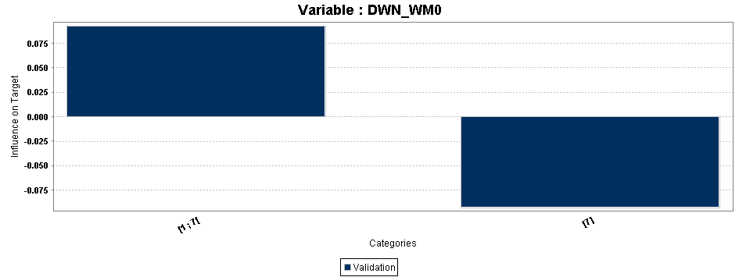
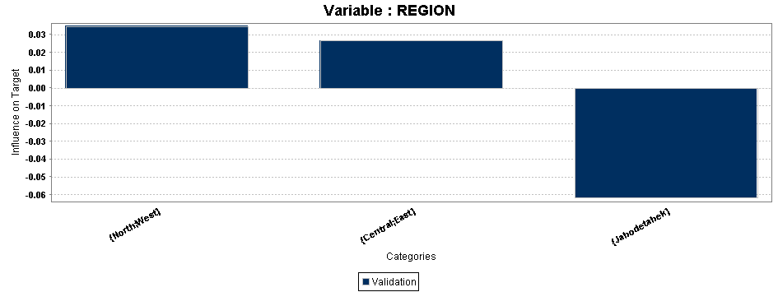
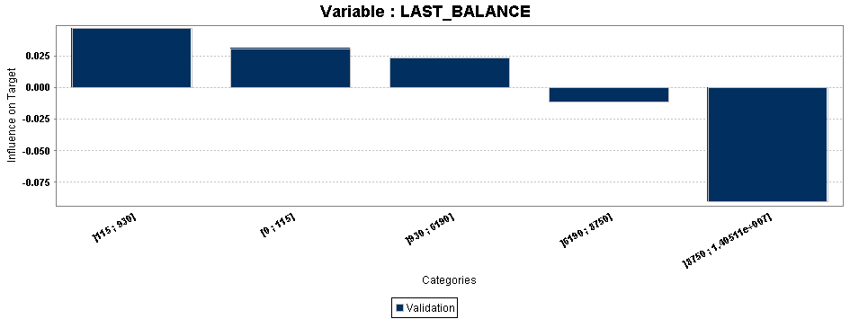
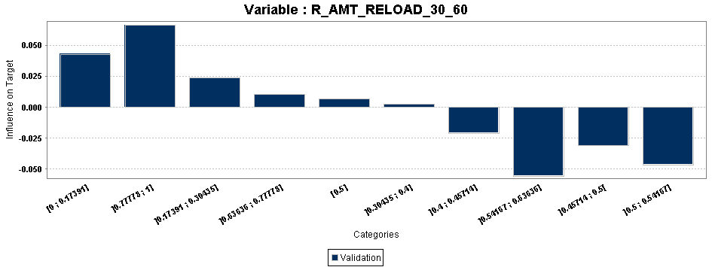
Significant variables
Total Days With Network current week
Region (Wilayah)
Subs with lesser DWN in current week are more likely to be sleeper
Subs in Jabodetabek area are less likely to be sleeper
Last Balance (Sisa Pulsa)
Ratio of Reload Amount (Pengisian Pulsa)
Subs with lesser last balance are more likely to be sleeper
Subs with consistent reload amount are less likely to be sleeper

Slide 11
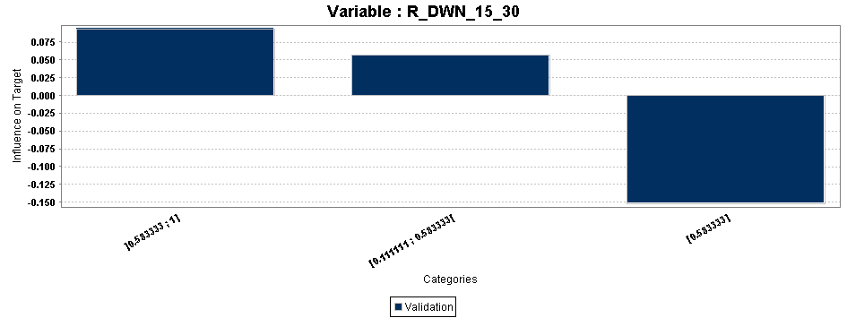
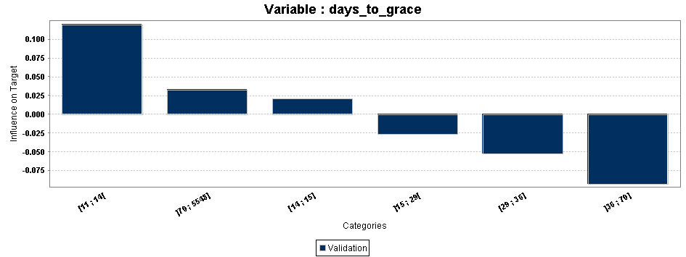
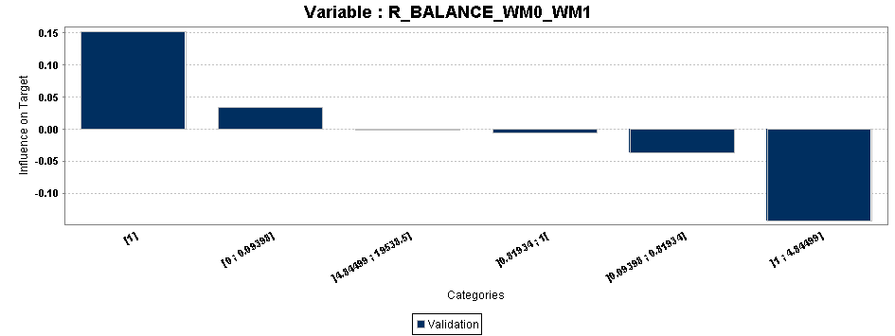
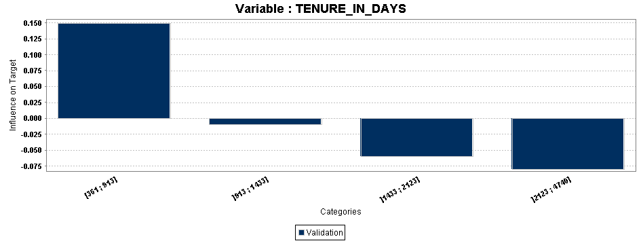
Significant variables
Ratio of Days With Network
Days to Grace (Hari menuju masa tenggang)
Subs with consistent network attachment in the current month are less likely to be sleeper
Subs with lower days to grace are less likely to be sleeper
Ratio of Balance (Pulsa)
Tenure (Masa Aktif Kartu SIM)
Subs with higher balance ratio in recent week are less likely to be sleeper
Subs with higher tenureare less likely to be sleeper

Slide 12
Churn Risk Model – Performance
Lift Chart
Population Validation
4.8 lift of churner prediction on the 1st decile

Slide 13
Grid Segmentation
Customer rating
A
C
E
High
B
F
Med
Low
D
Customer value based
rating
Low
Med
High
Churn Risk
Reassure anyway (good customer)
No churn expected
Will not churn but requires Sweetener (give campaign discount for voice,sms, or data)
Not worth saving (bad customer)
Will churn & definitely worth saving
Worth saving
High potential: 40K +
Medium potential: 15-40K
Low potential: < 15K
High risk: decile 1-2
Medium risk: decile 3-6
Low risk: decile 7-10

